Slide 1





Aagricultural Raw Material Analysis
Student Details
Name: Roja R
NM Id: au2021107016
College Name: College Of Engineering Guindy- Chennai.

Slide 2

Aagricultural Raw Material Analysis
Disclaimer
The content is curated from online/offline resources and used for educational purpose only

Slide 3
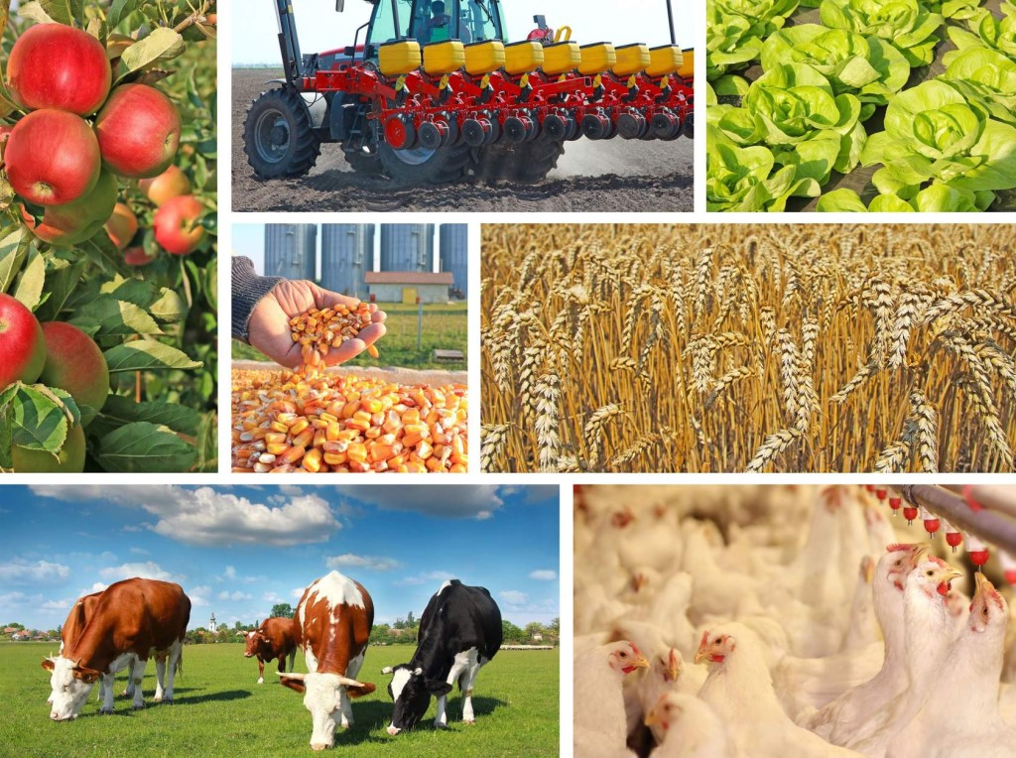
Aagricultural Raw Material Analysis
Course Outline
Abstract
Problem Statement
Aims, Objective & Proposed System/Solution
Introduction to Agricultural Raw Material Analysis
Importance of Data Analysis in Agriculture
Techniques and Tools for Raw Material Analysis
Model Development & Algorithm
Case Studies and Applications
Future Scope
Video of the Project
Conclusion
Reference

Slide 4


Aagricultural Raw Material Analysis
Abstract
In agriculture sector where farmers and agribusinesses have to make innumerable decisions every day and intricate complexities involves the various factors influencing them. An essential issue for agricultural planning intention is the accurate yield estimation for the numerous crops involved in the planning.
Data mining techniques are necessary approach for accomplishing practical and effective solutions for this problem. Agriculture has been an obvious target for big data. Environmental conditions, variability in soil, input levels, combinations and commodity prices have made it all the more relevant for farmers to use information and get help to make critical farming decisions.
This paper focuses on the analysis of the agriculture data and finding optimal parameters to maximize the crop production using data mining techniques like PAM, CLARA, DBSCAN and Multiple Linear Regression. Mining the large amount of existing crop, soil and climatic data, and analyzing new, non-experimental data optimizes the production and makes agriculture more resilient to climatic change.

Slide 5
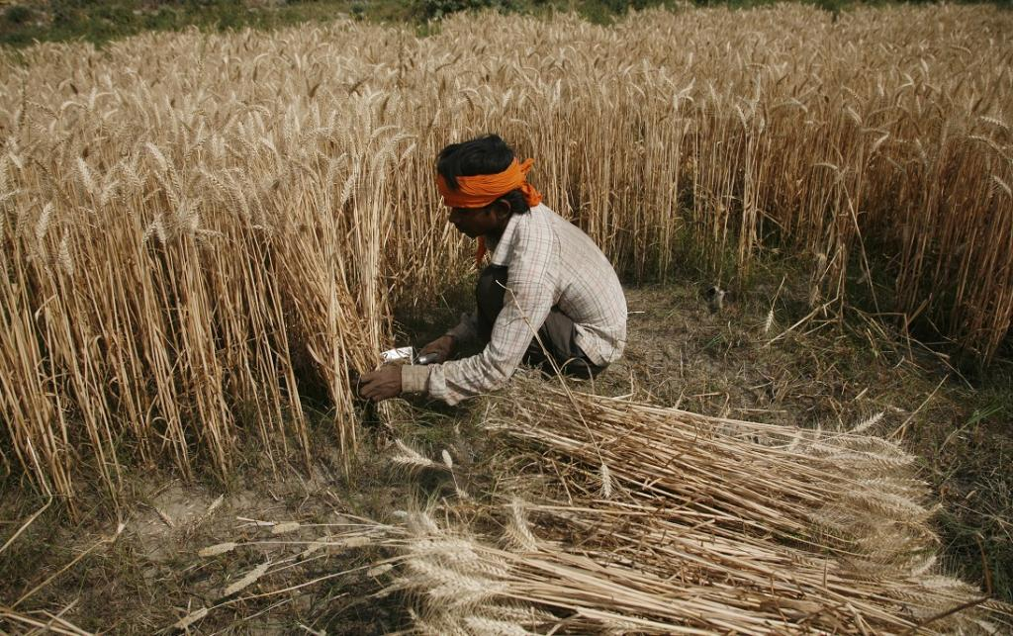
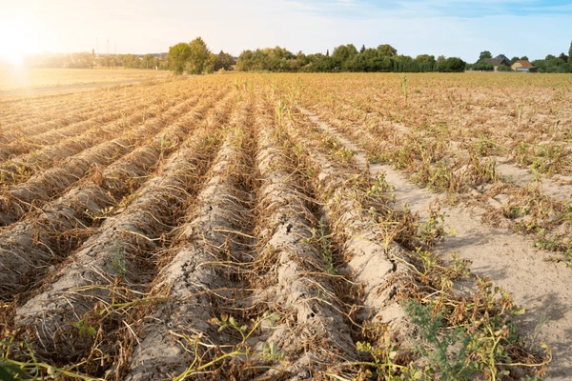
Aagricultural Raw Material Analysis
Problem Statement
Agricultural Raw Material Analysis - You are tasked to analyses agricultural-raw-material-prices dataset over the years (EDA) Find the high-range and low-range raw materials according to their prices. high and low %Change materials Identify the range of prices changed over the years. Map a correlation between them using a heatmap.

Slide 6
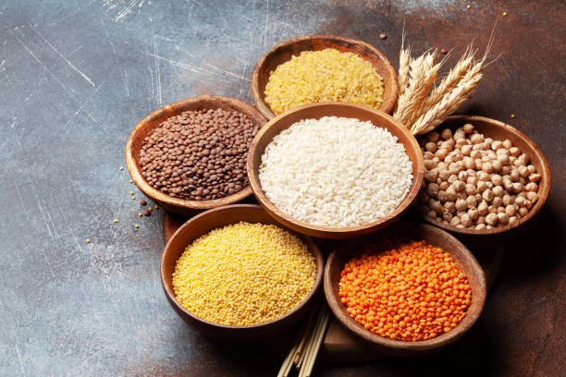
Aagricultural Raw Material Analysis
Aim and Objective
Aim:
The aim of this project is to develop a data-driven system for analyzing agricultural raw materials, providing actionable insights for farmers to optimize their farming practices.
Objectives:
Collecting and organizing raw material data from farms.
Implementing analytical techniques for data interpretation and pattern recognition.
Developing a user-friendly interface for farmers to access and utilize insights.
Proposed System/Solution:
Integration of IoT sensors for real-time data collection.
Utilization of machine learning algorithms for predictive analysis.
Development of a web-based platform for easy access and interpretation of insights.

Slide 7
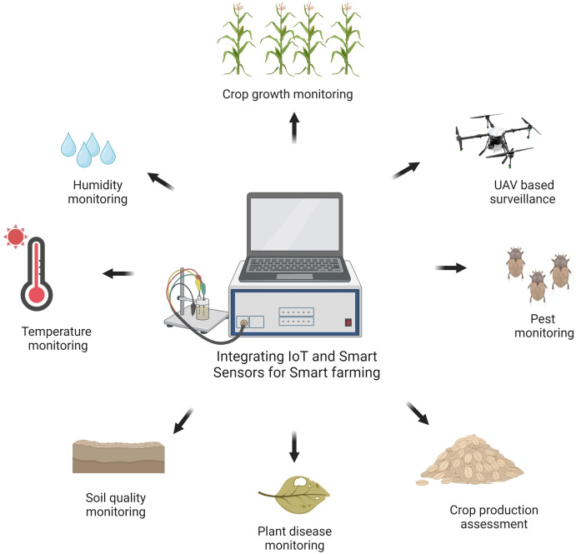
Aagricultural Raw Material Analysis
Introduction to Agricultural Raw Material Analysis
In the realm of agriculture, understanding the composition and quality of raw materials is paramount. Agricultural raw material analysis serves as the cornerstone for optimizing farming practices and ensuring sustainable agricultural production.
By analyzing raw materials, farmers gain insights crucial for informed decision-making regarding crop management, resource allocation, and marketing strategies. However, traditional farming methods often rely on subjective observations, presenting challenges such as inefficiencies and suboptimal results.
Through data-driven approaches and advanced analytical techniques, the objective is to empower farmers with actionable insights to enhance crop productivity and achieve sustainable agricultural development.

Slide 8
Aagricultural Raw Material Analysis
Importance of Data Analysis in Agriculture
Enhances Decision-Making: Data analysis provides farmers with valuable insights into crop performance, soil health, and environmental factors, enabling informed decision-making for improved agricultural practices.
Precision Agriculture: Data-driven analysis allows for precise and targeted application of resources such as water, fertilizers, and pesticides, optimizing yields while minimizing environmental impact.
Predictive Modeling: By analyzing historical data and current trends, farmers can develop predictive models for weather patterns, crop diseases, and pest infestations, enabling proactive management strategies.
Quality Assurance: Analyzing data on crop quality, nutrient levels, and contaminants ensures compliance with food safety standards and enhances the marketability of agricultural products.

Slide 9
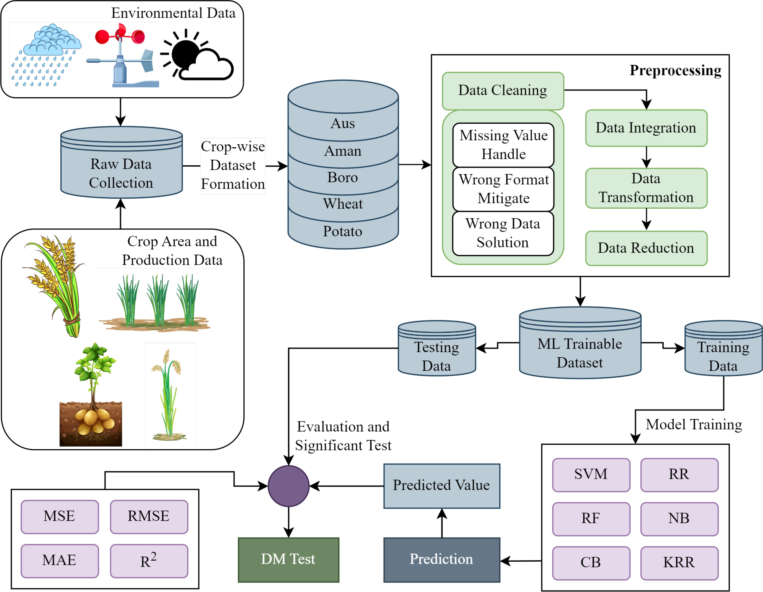
Aagricultural Raw Material Analysis
Model Development Process:
Data Preprocessing: Cleaning and organizing raw material data.
Feature Engineering: Extracting relevant features for analysis.
Model Selection: Choosing appropriate machine learning algorithms.
Training and Evaluation: Training the model on historical data and evaluating its performance.
Algorithm:
Example: Random Forest for Crop Yield Prediction
Random Forest is a versatile machine learning algorithm that can handle complex datasets and provide accurate predictions for crop yield based on various input parameters.

Slide 10
Aagricultural Raw Material Analysis
Techniques and Tools for Raw Material Analysis
Spectroscopy
Infrared spectroscopy
Near-infrared spectroscopy (NIRS)
X-ray fluorescence (XRF) spectroscopy
Chromatography
Gas chromatography (GC)
Liquid chromatography (LC)
High-performance liquid chromatography (HPLC)
Mass Spectrometry
DNA Sequencing
Remote Sensing
Data Analytics Software
Service and Tools Required

Slide 11
Tools:
1. Statistical Software: Statistical software such as R, Python (with libraries like NumPy, pandas, and SciPy), and MATLAB are commonly used for data analysis and statistical modeling in agricultural raw material analysis. These tools enable users to perform descriptive statistics, regression analysis, time series analysis, and hypothesis testing on agricultural data.
2. Data Visualization Tools: Data visualization tools like Tableau, Power BI, and matplotlib (for Python) are used to create interactive charts, graphs, maps, and dashboards to visualize agricultural data and trends. These tools help in presenting insights, identifying patterns, and communicating findings effectively to stakeholders.
3. Geographic Information Systems (GIS): GIS software such as ArcGIS, QGIS, and Google Earth Pro are used to analyze spatial data related to agricultural land, crops, soil types, weather patterns, and other geographic factors. GIS tools enable users to create maps, perform spatial analysis, and make informed decisions about land management and agricultural planning.

Slide 12
Data Collection Services:
These services collect and provide access to agricultural data from diverse sources, including government agencies, international organizations, research institutions, and private companies.
Market Research Services:
Market research firms specialize in collecting and analyzing data on agricultural markets, including supply, demand, pricing trends, consumer preferences, and competitive landscape.
Commodity Price Reporting Services:
These services provide real-time or delayed price information for agricultural commodities traded in various markets worldwide.
Remote Sensing and Satellite Imagery Services:
Remote sensing companies use satellite imagery, aerial photography, and geospatial data to monitor agricultural land, crop health, vegetation indices, soil moisture levels, and other environmental variables

Slide 13
Future Scope
Aagricultural Raw Material Analysis
Expansion of Data Sources:
Integration of Satellite Imagery: Incorporating satellite imagery data for enhanced analysis of crop health and growth patterns.
Weather Data Integration: Utilizing weather data to predict environmental impacts on crop yield.
Incorporation of Advanced Technologies:
Blockchain for Supply Chain Transparency: Implementing blockchain technology to track and trace agricultural products from farm to consumer, ensuring transparency and quality control.
Edge Computing for Real-time Analysis: Deploying edge computing devices for real-time analysis of agricultural data, enabling faster decision-making and response.
Collaboration with Research Institutions:
Partnering with research institutions for continuous improvement and innovation in agricultural data analysis techniques.

Slide 14
The future scope of agricultural raw material analysis is broad and evolving, driven by technological advancements, demographic shifts, environmental challenges, and changing market dynamics. Here are some key areas that represent the future scope of agricultural raw material analysis
Precision Agriculture:
The adoption of precision agriculture technologies, such as sensors, drones, satellite imagery, and machine learning algorithms, will continue to increase. These technologies enable farmers to monitor crop health, optimize irrigation and fertilizer usage, and maximize yields while minimizing inputs and environmental impact.
Big Data and Analytics:
The volume, variety, and velocity of agricultural data are increasing rapidly. Advanced data analytics techniques, including artificial intelligence, predictive modeling, and data mining, will play a crucial role in analyzing large datasets to derive actionable insights for farmers, agribusinesses, and policymakers.
Digital Platforms and Marketplaces:
Digital platforms and marketplaces are transforming agricultural markets by connecting farmers directly with buyers, processors, and consumers. Agricultural raw material analysis will focus on developing online platforms, mobile apps, and e-commerce solutions to facilitate transparent and efficient trade of agricultural commodities.

Slide 15
Regenerative Agriculture:
Regenerative agriculture practices aim to restore and enhance ecosystem health, soil fertility, and biodiversity while sequestering carbon from the atmosphere. Agricultural raw material analysis will evaluate the benefits of regenerative practices, such as cover cropping, crop rotation, and agroforestry, for soil conservation, carbon sequestration, and farm profitability.
Urban Agriculture:
Urbanization and population growth are driving interest in urban agriculture initiatives, such as rooftop gardens, vertical farms, and community gardens. Agricultural raw material analysis will explore the potential of urban agriculture to provide fresh produce, improve food security, and promote local food systems in urban areas.
10.Policy Support and Innovation:
Governments, research institutions, and international organizations are investing in agricultural research, innovation, and policy support to address food security, rural development, and sustainability challenges.

Slide 16
Conclusion
Aagricultural Raw Material Analysis
In conclusion, agricultural raw material analysis holds immense potential for revolutionizing modern farming practices. By harnessing the power of data-driven approaches, farmers can optimize their resource allocation, improve crop yield, and ensure sustainable agricultural practices.
Through the analysis of agricultural data, including production statistics, market trends, weather patterns, and policy developments, stakeholders gain valuable insights into supply-demand dynamics, price fluctuations, risk factors, and opportunities in the agricultural market. This knowledge empowers farmers, agribusinesses, policymakers, investors, and consumers to address key challenges and capitalize on emerging trends in the agricultural sector.
The proposed system offers a systematic solution for addressing the challenges faced in traditional farming methods and paves the way for a more efficient and productive agricultural sector.
In essence, agricultural raw material analysis is not just about analyzing data; it's about unlocking the potential of agriculture to nourish people, sustain the planet, and foster economic prosperity. By harnessing the power of information, technology, and collaboration, we can address the complex challenges facing agriculture and create a more sustainable and equitable food system for all.

Slide 17
References
Aagricultural Raw Material Analysis
https://www.sciencedirect.com/science/article/abs/pii/S0301421513012731
https://www.elibrary.imf.org/display/book/9781451943061/ch004.xml
https://iopscience.iop.org/article/10.1088/1755-1315/949/1/012025/pdf.

Slide 18
Thank you !

